Slide 1

The Basics of Public Health
The Basics of Public Health

Slide 2

Overview
Format
Questions to be addressed:
  What is public health?
  What is a public health system?
  Why take a public health approach?
  Can public health make a difference?

Slide 3

Learner Objectives
By the end of this presentation, participants will be able to…
    Define public health
    List the determinants of health
    Identify one example of local or state
    public health practice

Slide 4

What is Public Health?
Definitions vary
Key terms
  Population health
  Prevention
Notes:
“The science and art of preventing disease, prolonging life and promoting health and efficiency through organized community efforts” (Winslow, 1920)
“Fulfilling society’s interest in assuring conditions in which people can be healthy” (IOM report, 1988)

Slide 5


Public Health in the US
~Vision~
Healthy People in Healthy Communities
~Mission~
Promote physical and mental health
and
Prevent disease, injury, disability
Notes:
Communities – the population perspective
Prevent – primary and secondary prevention approach

Slide 6



Public Health…
Prevents epidemics and the spread of disease
Protects against environmental hazards
Responds to disasters and assists communities in recovery
Notes:
Spread of Disease: Example – West Nile Virus
Environmental Hazards: Example – Lead Poisoning
Responds to Disasters: Example - Bioterrorism

Slide 7



Public Health…
Prevents injuries
Promotes healthy behaviors
Assures the quality and accessibility of health services
Notes:
Prevents injuries: Example – head trauma due to bicycle crash
Promote healthy behavior: Example – smoking cessation, good nutrition, etc.
Assure health services: Example – access to prenatal care

Slide 8

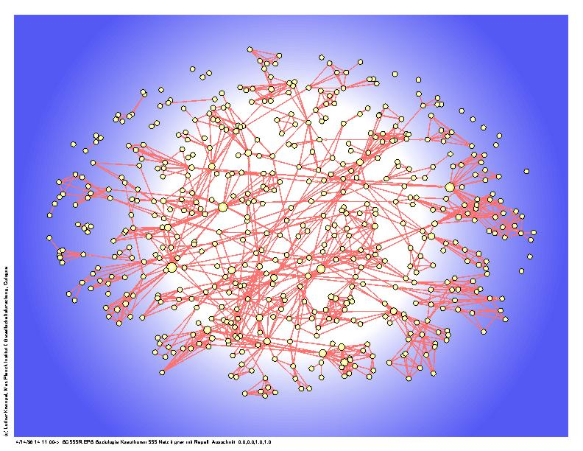
A Public Health System
Who?
  Public entities
  Private entities
  Voluntary entities
What?
  A network
Notes:
WHO: All public, private, and voluntary entities that contribute to public health in a given area
WHAT: A network of entities with differing roles, relationships, and interactions. All entities contribute to the health and well-being of the community.
NOTE: A public health system is more than the public health agency

Slide 9
The Public Health System
Police
Home Health
EMS
Community Centers
Churches
Corrections
MCOs
Health Department
Parks
Schools
Elected Officials
Doctors
Hospitals
Nursing Homes
Mass Transit
Philanthropist
Environmental Health
Civic Groups
CHCs
Fire
Tribal Health
Economic Development
Laboratory Facilities
Drug Treatment
Mental Health
Employers

Slide 10




Workforce
Diverse and Multidisciplinary
Examples…
  🡺 Biostatisticians
  🡺 Dieticians
  🡺 Environmental Health Specialists
  🡺 Behavioral Health Specialists
Notes:
Public health professionals include, but are not limited to the following:
u Administrators
u Biostatisticians
u Dieticians
u Environmental health specialists
u Epidemiologists
u Health care providers
u Health communication specialists
u Health educators
u Health law experts
u Labratorians
u Occupational health specialists
u Public health nurses
u Researchers
u Sanitarians
u Social scientists
u Toxicologists
u Others

Slide 11
Core Components
ASSESSMENT
of the health of the community
POLICY DEVELOPMENT
in the public’s interest
ASSURANCE
of the public’s health
Notes:
Assessment
This function includes the regular collection, analysis, and sharing of health data and information about risks and resources in a community. The purpose of this function is to identify trends in illness, injury, and death including the factors that may cause these conditions.
Policy Development
Information collected during the assessment phase is often used to develop local and state health policies. Good public policy development involves the consideration of political, organizational, and community values.
Assurance
This function includes the assurance of the availability of quality and effective programs and services necessary to achieve the agreed-upon goals.

Slide 12


10 Essential Services
Monitor health status to identify community health problems
Diagnose and investigate
health problems and health
hazards in the community
Notes:
Public health professionals include, but are not limited to the following:
u Administrators
u Biostatisticians
u Dieticians
u Environmental health specialists
u Epidemiologists
u Health care providers
u Health communication specialists
u Health educators
u Health law experts
u Labratorians
u Occupational health specialists
u Public health nurses
u Researchers
u Sanitarians
u Social scientists
u Toxicologists
u Others

Slide 13


10 Essential Services
Inform, educate, and
empower people about
health issues
Mobilize community partnerships
to identify and solve
health problems
Notes:
Public health professionals include, but are not limited to the following:
u Administrators
u Biostatisticians
u Dieticians
u Environmental health specialists
u Epidemiologists
u Health care providers
u Health communication specialists
u Health educators
u Health law experts
u Labratorians
u Occupational health specialists
u Public health nurses
u Researchers
u Sanitarians
u Social scientists
u Toxicologists
u Others

Slide 14


10 Essential Services
5. Develop policies and
plans that support
health efforts
Enforce laws and regulations that
protect health and
ensure safety
Notes:
Public health professionals include, but are not limited to the following:
u Administrators
u Biostatisticians
u Dieticians
u Environmental health specialists
u Epidemiologists
u Health care providers
u Health communication specialists
u Health educators
u Health law experts
u Labratorians
u Occupational health specialists
u Public health nurses
u Researchers
u Sanitarians
u Social scientists
u Toxicologists
u Others

Slide 15


10 Essential Services
Link people to personnel
health services and
assure the provision of
health care
8. Assure a competent public health
and health care
workforce
Notes:
Public health professionals include, but are not limited to the following:
u Administrators
u Biostatisticians
u Dieticians
u Environmental health specialists
u Epidemiologists
u Health care providers
u Health communication specialists
u Health educators
u Health law experts
u Labratorians
u Occupational health specialists
u Public health nurses
u Researchers
u Sanitarians
u Social scientists
u Toxicologists
u Others

Slide 16


10 Essential Services
Evaluate the effectiveness,
accessibility, and quality
of services
10. Research for new insights and
innovative solutions to
health problems
Notes:
Public health professionals include, but are not limited to the following:
u Administrators
u Biostatisticians
u Dieticians
u Environmental health specialists
u Epidemiologists
u Health care providers
u Health communication specialists
u Health educators
u Health law experts
u Labratorians
u Occupational health specialists
u Public health nurses
u Researchers
u Sanitarians
u Social scientists
u Toxicologists
u Others

Slide 17

Public Health Approach
Public Health
Model
Medical
Model
Versus
Notes:
Public health professionals include, but are not limited to the following:
u Administrators
u Biostatisticians
u Dieticians
u Environmental health specialists
u Epidemiologists
u Health care providers
u Health communication specialists
u Health educators
u Health law experts
u Labratorians
u Occupational health specialists
u Public health nurses
u Researchers
u Sanitarians
u Social scientists
u Toxicologists
u Others

Slide 18

Determinants of Health
Notes:
Public health professionals include, but are not limited to the following:
u Administrators
u Biostatisticians
u Dieticians
u Environmental health specialists
u Epidemiologists
u Health care providers
u Health communication specialists
u Health educators
u Health law experts
u Labratorians
u Occupational health specialists
u Public health nurses
u Researchers
u Sanitarians
u Social scientists
u Toxicologists
u Others

Slide 19
Determinants of Health
Genetic
Behavioral
Social
Environmental
Personal health care
Notes:
Public health professionals include, but are not limited to the following:
u Administrators
u Biostatisticians
u Dieticians
u Environmental health specialists
u Epidemiologists
u Health care providers
u Health communication specialists
u Health educators
u Health law experts
u Labratorians
u Occupational health specialists
u Public health nurses
u Researchers
u Sanitarians
u Social scientists
u Toxicologists
u Others

Slide 20




Achievements
Vaccination
Safer Workplaces
Safer & Healthier Food
Motor Vehicle Safety
Notes:
Public health professionals include, but are not limited to the following:
u Administrators
u Biostatisticians
u Dieticians
u Environmental health specialists
u Epidemiologists
u Health care providers
u Health communication specialists
u Health educators
u Health law experts
u Labratorians
u Occupational health specialists
u Public health nurses
u Researchers
u Sanitarians
u Social scientists
u Toxicologists
u Others

Slide 21



Achievements
Control of Infectious Diseases
Family Planning
Decline in Deaths from Heart Disease & Stroke
Notes:
Public health professionals include, but are not limited to the following:
u Administrators
u Biostatisticians
u Dieticians
u Environmental health specialists
u Epidemiologists
u Health care providers
u Health communication specialists
u Health educators
u Health law experts
u Labratorians
u Occupational health specialists
u Public health nurses
u Researchers
u Sanitarians
u Social scientists
u Toxicologists
u Others

Slide 22



Achievements
Recognition of Tobacco Use as a Health Hazard
Healthier Mothers and Babies
Fluoridation of Drinking Water
Notes:
Public health professionals include, but are not limited to the following:
u Administrators
u Biostatisticians
u Dieticians
u Environmental health specialists
u Epidemiologists
u Health care providers
u Health communication specialists
u Health educators
u Health law experts
u Labratorians
u Occupational health specialists
u Public health nurses
u Researchers
u Sanitarians
u Social scientists
u Toxicologists
u Others

